Slide 1

Puberty
Year 7 Health – 2024
Lesson 5

Slide 2

Today’s focus
Identify skills, emotions and items necessary to survive puberty.
Define hormones, primary and secondary sex characteristics.
Identify the main male and female sex hormones.
Create a timeline summary of the changes that occur during puberty.

Slide 3

(pg. 41)
In the first 5 minutes of each lesson, you will complete your revision page, you will find these throughout your booklet.
The revision page consists of three questions. It will need to be completed in detail. One-word answers will not be accepted.
The three questions :
What two concepts or ideas did I learn in class last week?
What did I find interesting about last week’s lesson? Provide a specific example.
Any questions or new words you have learnt?
The teacher will go over this each lesson with you to see what you have learnt. It is a great way for you to revisit content and test your memory.

Slide 4
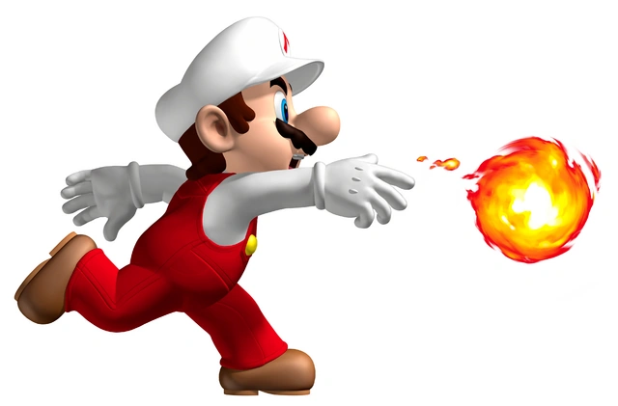

HOOK: Rapid Fire Puberty Changes (pg.42)
Working in pairs.
List as many changes that occur during puberty as possible.
Think about PHYSICAL, SOCIAL and EMOTIONAL changes.
The pair to get the most correct changes wins a prize.
You have 2 minutes.

Slide 5
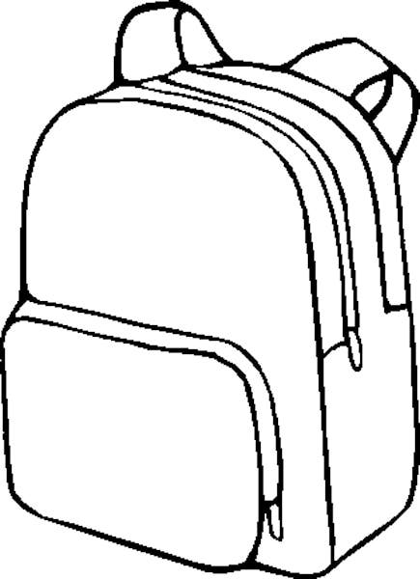
Activity 1: puberty backpack (pg.43)
How can you prepare for puberty?
Create a puberty backpack filled with items and skills you can use to survive the years of puberty.
Make this backpack specific to yourself – what will you need?
In the small pocket – skills and emotions you can use.
In the big pocket – physical items you can use.
You can write words OR draw pictures.
Think about all the changes that can occur during puberty and how you can address/manage/deal with them.
You have 15 minutes.
Notes:
Adjust time as necessary
SUGGESTION – complete this activity as a hard copy for everyone. That way they can take it home with them to remind them of their survival kit. It will also allow the students to get a little creative.
Resources – backpack w/s (one per student), coloured pencils/texters.
ALTERNATIVE – swap the order of this lesson and complete the timeline activity as activity 1, and the backpack as activity 2.
OPTIONAL – set homework for students to actually go and create their own survival kit at home with the physical items they identified as needing.

Slide 6
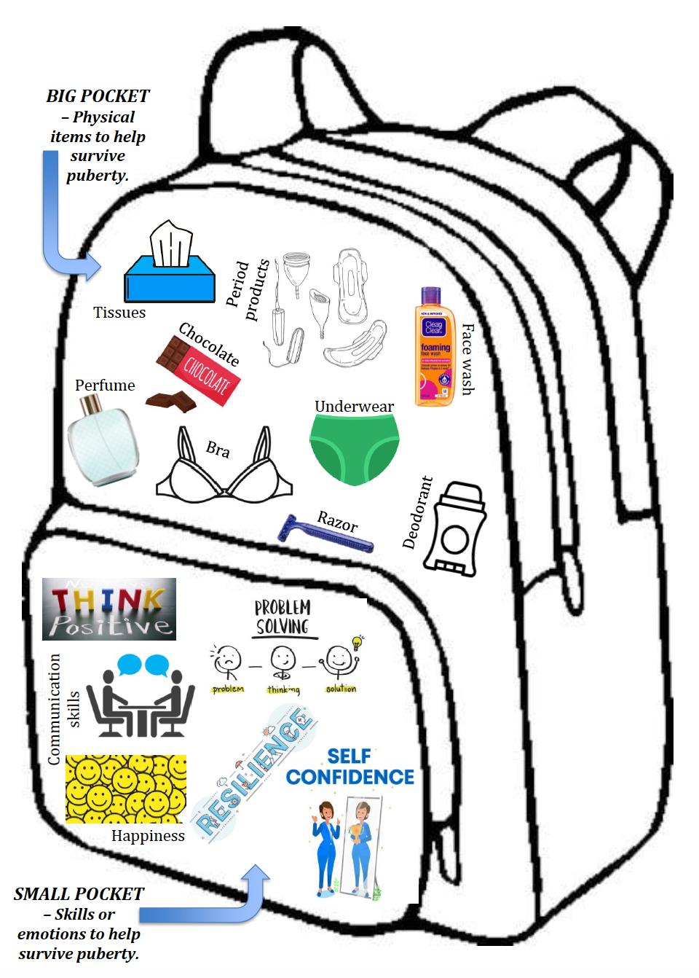
Notes:
Example of a puberty backpack. This example is not specific to either gender.
Some other examples can include:
Organisational skills
Kindness – to self and others

Slide 7

GLOSSARY: (Pg. 5)
At the front of your books is your glossary. Turn to your glossary and add the following words and their definitions:
Hormones
Chemical messengers that tell the body what to do.
After being made in one part of the body, they travel to other parts of the body where they help control how cells and organs do their work.
Primary Sex Characteristics
Changes that occur in the body to prepare for reproduction (e.g., ovulation in girls, sperm production in boys).
Secondary Sex Characteristics
Changes that occur in the body not related to reproduction but are a sign of sexual maturity (e.g., breast development in girls, voice deepening in boys).
Notes:
Relevant to test

Slide 8
How does it all happen? (pg.44)
The physical changes that occur at puberty are triggered by substances known as HORMONES.
They are chemical messengers that travel in the blood stream from the place where they are made (called glands) to the place where they do their work. Each hormone has a specific job.
The HYPOTHALAMUS (located in the brain) tells the body to release ’Gonadotropin Releasing Hormone’ (GnRH). This hormone stimulates the PITUITARY GLAND.
The PITUITARY GLAND, deep inside your brain, then sends out hormones to our sex organs to get them to start making SEX HORMONES.
For boys, it sends a signal to the TESTES.
For girls, it sends a signal to the OVARIES.
Notes:
Fill in the blanks
RELEVANT TO TEST

Slide 9
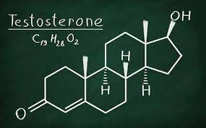
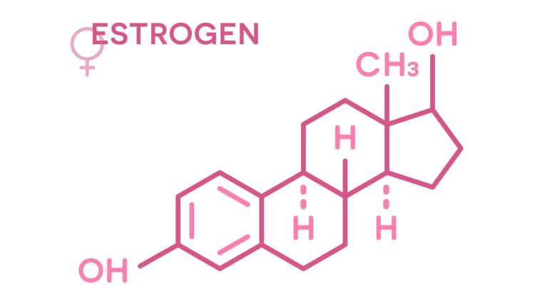
HOW DOES IT ALL HAPPEN? (pg.44)
Both boys and girls make the same sex hormones. The main ones are TESTOSTERONE and OESTROGEN.
Boys make lots of testosterone, not so much oestrogen. Therefore, the primary male sex hormone is TESTOSTERONE.
Girls make lots of oestrogen (primary sex hormone), not so much testosterone. Therefore, the primary female sex hormone is OESTROGEN.
Another hormone in girls that is essential during puberty is PROGESTERONE.
Testosterone and oestrogen help in the initiation of the primary and secondary sex characteristics in males and females.
Notes:
Fill in the blanks
RELEVANT TO TEST

Slide 10
Primary & Secondary Sex Characteristics (pg.45)
Until puberty, the growth and development of boys and girls is very similar. At puberty, under the influence of hormones, this development progresses along different paths.
The physical changes that occur during puberty can be broken down into Primary and Secondary Sex Characteristics.
PRIMARY Sex Characteristics are those changes that are DIRECTLY RELATED TO REPRODUCTION.
In boys, this includes the production of sperm in the testes.
In girls, this includes the onset of menstruation and ovulation.
The production of sperm and the onset of menstruation and ovulation are indicators that the person is now capable of reproducing.
SECONDARY Sex Characteristics are those changes that are not directly related to reproduction but are A SIGN OF SEXUAL MATURITY.
In boys, this includes the development of facial hair, the voice deepening (or ‘cracking’) and more muscle mass.
In girls, this includes the development of breasts and widening hips.
Notes:
Fill in the blanks
RELEVANT TO TEST

Slide 11
Activity 2: Puberty Timeline (pg.45-48)
Now we know about some of the changes that can happen and why they happen during puberty, but WHEN do these changes start to occur?
Your task:
Read through the information on the stages of puberty for males and females in your workbook.
Summarise and identify the changes that occur in each age bracket.
Write your answers in the space provided on the timeline in your workbook.
An example for each has been done for you in your books. You have 15 minutes and may work in pairs.
REVIEW question:
Do you notice anything when you compare the changes between males and females across your timeline? Any similarities or differences?
ANSWER: girls generally tend to start earlier than boys, and boys can continue their development longer and into their 20’s. Also, many of the changes are similar (i.e., pubic hair, growth spurts, hormonal changes etc.)
Notes:
Example and answers on the next slide.
ALTERNATIVE – swap the order of this lesson and complete the timeline activity as activity 1, and the backpack as activity 2.
OPTIONAL for students to work in pairs.

Slide 12
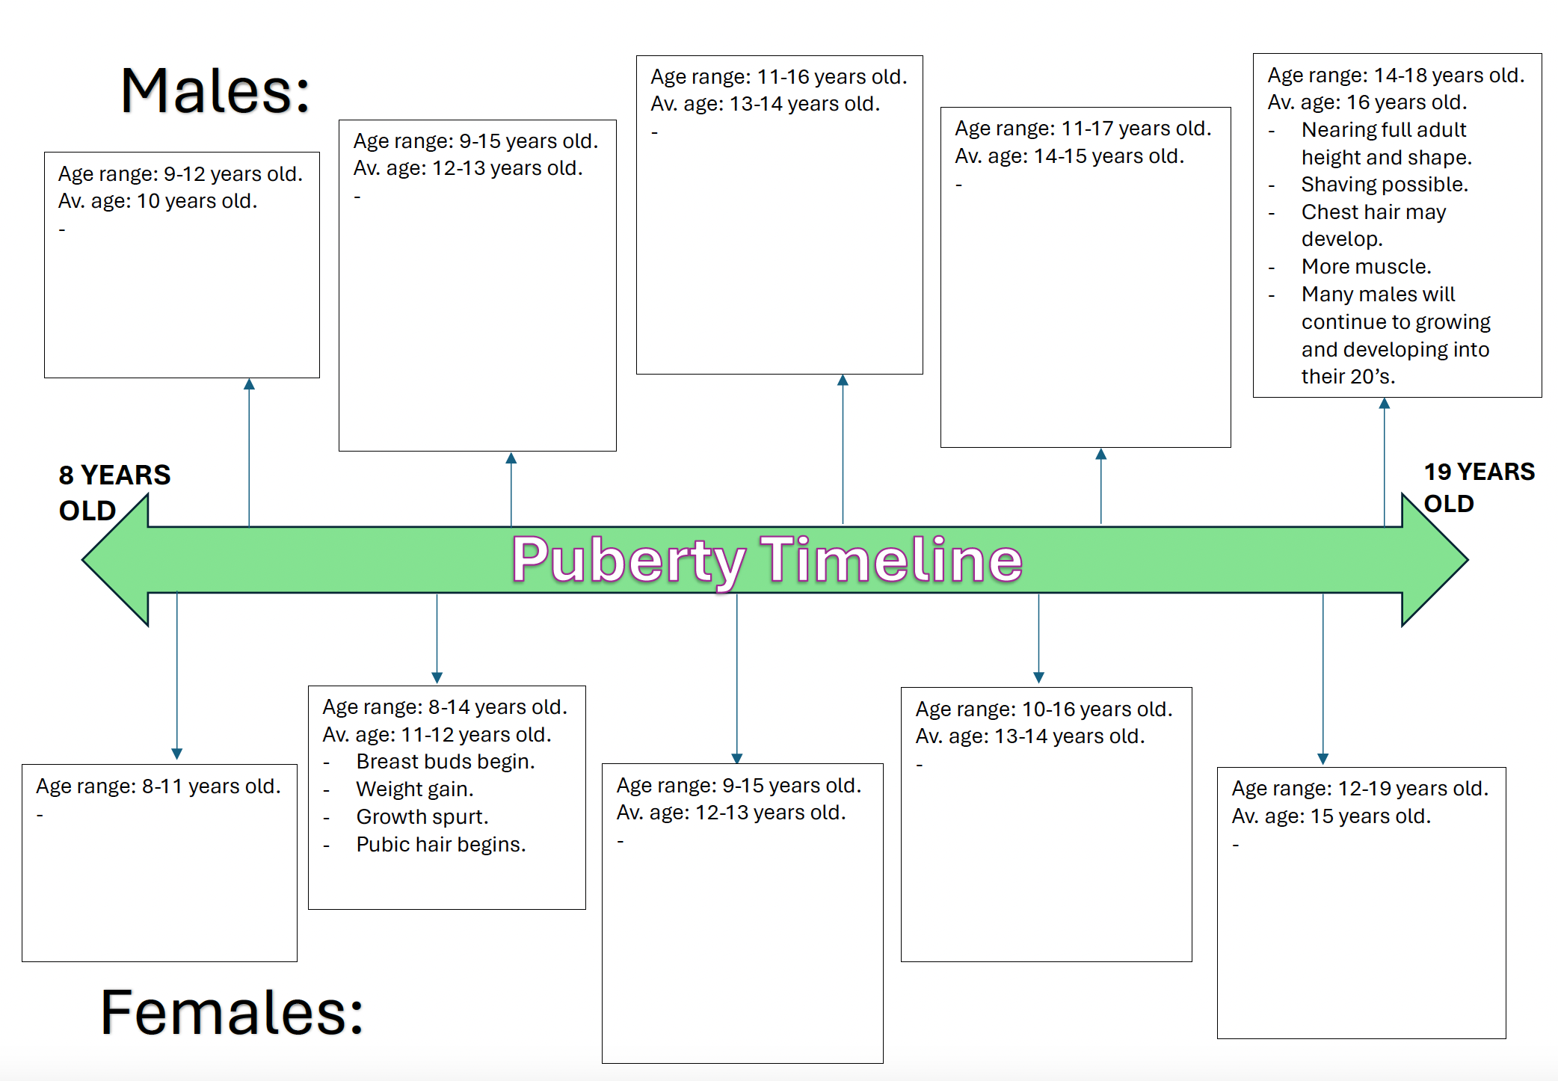
Notes:
Student version – in their workbooks. Use this to explain the examples.
Read the information from the teacher book.
- For males, the last paragraph has been summarised into the last box.
- For females, the second paragraph has been summarised into the second box).
Answers on the next slide

Slide 13
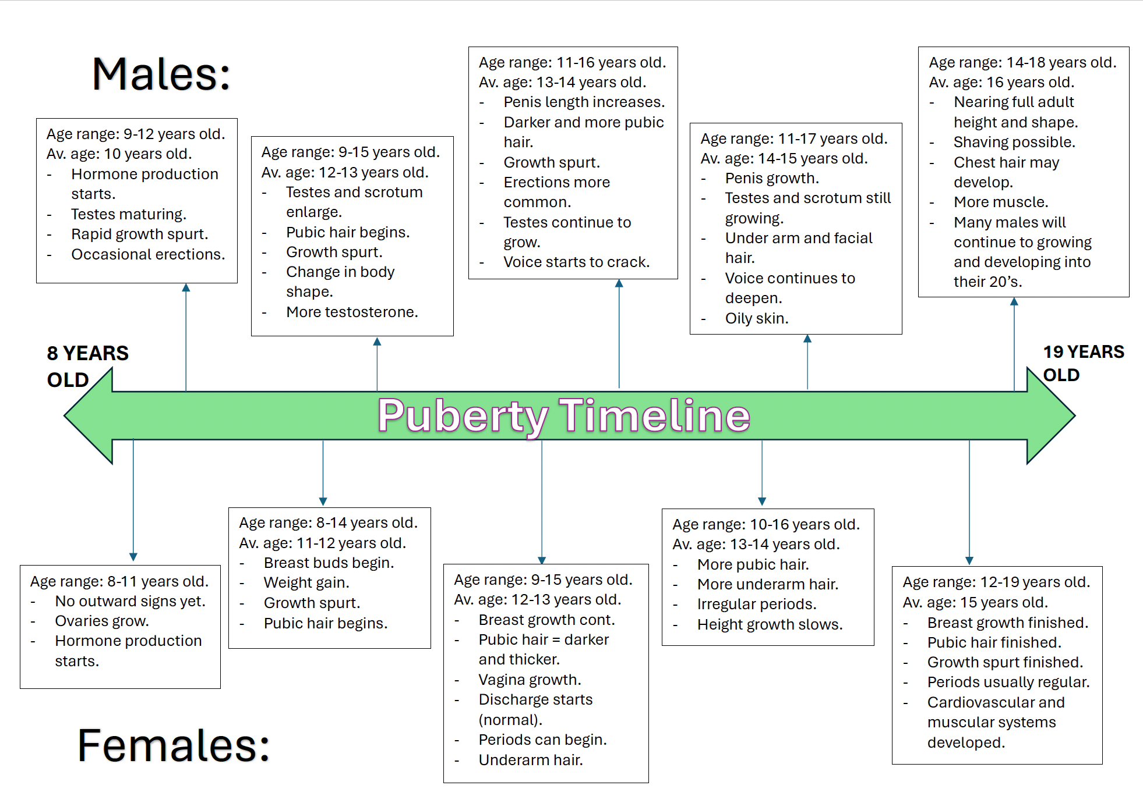

Slide 14
Remember…
Everyone has their own experience with puberty.
While it is something that everyone will go through, no two people are the same.
Our body’s will grow and begin to develop at different rates.
We are all unique.
Notes:
Emphasise that everyone has their own experience with puberty – no two people are the same and will progress at different speeds
Not in their workbooks.

Slide 15

3, 2, 1 R.I.Q:
Each person will receive a sticky note.
On your sticky note, complete the following:
- 3 x pieces of information you can RECALL from today
- 2 x things you found INTERESTING
- 1 x QUESTION you still have
Hand your note to your teacher on your way out.
Notes:
Resources – sticky notes.

